Slide 1
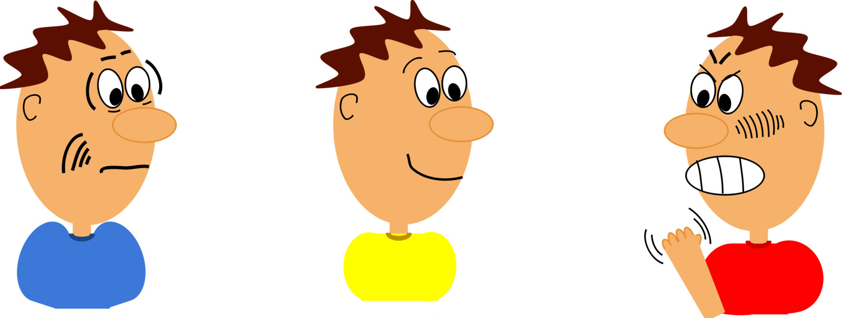
Assertive Communication
Bhagya Hapuarachchi
National Institute of Business Management

Slide 2
Aims of the Session
To discuss what assertive communication is
To understand how assertive communication can be used for effective communication.
To discuss barriers of assertive communication

Slide 3
What is Assertive Communication?
Assertive communication is a style of communication which involves an individual to interact in a way that respects the speaker’s rights and the rights of others.
This ensures that your opinions, ideas, and thoughts are understood by others and ensures that others do not feel that their ideas have been put down by you.

Slide 4
What is Assertive Communication? Cont.
According to Lazarus (1971 cited in Pipas and Jaradat 2010), “the ability to say no, the ability to ask favors or make requests, ability to express positive and negative feelings, the ability to initiate, continue and finish a general conversation” can be considered to be assertive communication.
“Assertive behavior is an interpersonal behavior involving relatively honest and direct expression of thoughts and feelings that are socially appropriate and take into account the feelings and welfare of other people” (Rimm and Masters 1979 cited in Pipas and Jaradat 2010).

Slide 5
What is Assertive Communication? Cont.
Assertiveness also gives one the ability to be open about his/her feelings in an appropriate manner.
Assertive communication is respectful of others and at the same time clear and firm in intent.
Assertive communication ensures that one’s needs are met while promoting respectful relationships.

Slide 6
What is Assertive Communication? Cont.
An assertive communicator listens to other’s ideas and thoughts. He/ she is also self-aware and responsible.
Principles of Assertive Communication
- Allows others to know how we feel and think
- Results in positive relationships without having to sacrifice one’s own rights.

Slide 7
What is Assertive Communication? Cont.
- Trains others to treat us respectfully
- Allows others to know how their behavior negatively affects us and provides them an opportunity to change their behaviour

Slide 8
What is Assertive Communication? Cont.
H - honest
A - appropriate
R - respectful
D - direct
Assertive communication ensures that both individuals are equally important.

Slide 9
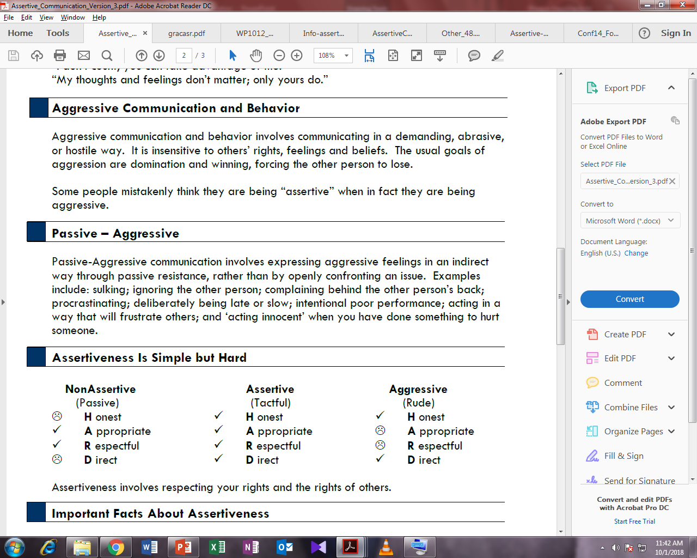
Passive, Aggressive, and Passive-Aggressive

Slide 10
What is Assertive Communication?
Humans are taught that they should always concede or defer to others.
What is your stance on this?
Assertive communication helps individuals avoid:
- resentment
- frustration
- anxiety and avoidance

Slide 11
Basic Assertive Rights
Having dignity and self-respect
Saying NO when justified without feeling guilty
Asking for what he/she wants directly
Feeling good about oneself
Being able to change one’s mind
Being able to make mistakes and take responsibility for them
Negotiating and reaching compromises when conflicts exist

Slide 12
Goals in Assertive Communication
Win-win situations
Mutually satisfactory compromise
Effective communication and negotiation

Slide 13
Assertive Skills
Fogging - giving a minimal calm response to slow down a situation which is likely to become unpleasant
Repetition/ Broken record technique
Self-disclosure - using ‘I’ statements
Workable compromise
Active listening

Slide 14
Developing Assertiveness: Techniques
Boundaries and expectations
De-triangulation
Addressing faulty cognitions: magnification, overgeneralization, personalization, splitting

Slide 15
Assertive Communication: Components
Empathy/ validation – respond to criticism with empathy
Statement of problem
Statement of what you want
Timing
Content

Slide 16
XYZ Formula: Communication
I feel X when you do Y in situation Z and I would like you………..
This formula helps an individual express what he/she feels.

Slide 17
Language in Assertive Communication Cont.
Minimise prefaces such as:
This may not be important...
I know this sounds silly...
I may be wrong...
It’s just that...
I was just wondering if... (Boschen 2013)

Slide 18
Saying “NO”
Plan your outcome
Acknowledge your rights – you have the right to say no
You are rejecting the request not the person
Use self-disclosure to show how you feel (say I think, I feel)
Be clear and specific

Slide 19
Saying “NO”
Pay attention to your body language
Empathise with the other person (show you understand their perspective)
Seek to reach a workable compromise (when appropriate/relevant)
Save yourself stress by asking for time and/or change your mind if necessary

Slide 20
Barriers to Assertive Communication
Cultural factors
Conflict resolution techniques practiced in families

Slide 21
NVC - Paralanguage
Voice, tone, pitch
Facial expressions – eye contact
Body language - hand gestures and posture

Slide 22
Advantages of Assertive Communication
Active participation in decision making
Being able to get what you want without alienating others
Emotional and intellectual satisfaction
High self-esteem

Slide 23
Assertive Communication: Activity
Group activity

Slide 24
QUESTIONS?

Slide 25
THANK YOU!

